Slide 1
Windows Tech Series Deployment Basics
Speaker 1
Title
Speaker 2
Title

Slide 2
Agenda
Day | Day 1 Deployment | Day 2 Management | Day 3 Security | Day 4 Windows for CSP
 |  |  |  | Deployment | Management | Security
Synopsis | Module 1 – Introduction | Module 1 – Base System Setup | Module 1 – Analysis Of Common Threats | Module 1 – Windows for SMB Partners
 | Module 2 – Applications & Updates | Module 2 – Configuration | Module 2 – Hardening Windows | Module 2 – Windows Ent. Subscription
 | Module 3 – Windows as a Service (WaaS) | Module 3 – Managing Client Devices | Module 3 – Advanced Threat Protection | Module 3 – Deployment
 | Module 4 – Browsers & Internet Security | Module 4 – Advanced management options I | Module 4 – Information Security (AIP/WIP) | Module 4 – Managing Updates
 | Module 5 – Secure Boot & Device Guard | Module 5 - Advanced management options II | Module 5 – Internet Security

Slide 3
There are 3 Windows 10 deployment choices for different customer situations
Existing Devices
New Devices
Custom Image
Managed in-place upgrade
Runtime configuration to customize without imaging
Reduced application, driver, and installation validation and deployment costs
In-Place Upgrade
Let Windows do the work
Preserve all data, settings, apps, drivers
Install (standard) OS image
Restore everything
Recommended for existing devices (Windows 7/8/8.1)
Provisioning
Configure new devices out of box
Upgrade OS to Windows Enterprise
Remove extra items (e.g. OEM)
Add organizational apps
Configure settings and security
New capability for new devices
Wipe-and-Load
Traditional process
Capture data and settings
Deploy (custom) OS image
Inject drivers
Install apps
Restore data and setting
Still an option for all scenarios
Notes:
We know that deploying a new version of Windows requires a lot of effort for organizations. Using a traditional wipe and reload process requires creating a custom Windows image for the organization, identifying and obtaining all the needed drivers and apps for reinstallation, and significant engineering effort to implement the process.
For Windows 10, we want to reduce that effort by moving to an in-place upgrade process for existing devices. We also want to provide new capabilities to help with the configuration of new computers, avoiding the need for reimaging those devices. And to help with the application compatibility process, we want to provide new tools to help.
For Windows 10, we will provide a few deployment choices. For existing computers, we believe the easiest approach is to leverage the in-place upgrade process to move from Windows 7, Windows 8, or Windows 8.1 directly to Windows 10. This process lets Windows do all the work for you – leveraging existing software distribution or patch deployment capabilities to initiate and monitor the upgrade process.
We will still fully support the traditional wipe-and-load process to, for customers that prefer to go that route.
We will also provide new runtime provisioning capabilities to help transform a new device from its initial out-of-box configuration into a fully-configured enterprise device. That transformation can change the SKU, install apps, apply configuration, and more. We believe this will enable organizations to effectively support choose your own device (CYOD) policies, giving end users more choice in the types of Windows devices they use.

Slide 4
Moving In-place

Slide 5

In-place upgrade is the preferred option for enterprises for existing devices
DEPLOYMENT TASKS
WINDOWS 7/8
WINDOWS 10 IN-PLACE UPGRADE*
Upgrade from either Windows 7, 8, or 8.1
Fast and reliable, with roll-back if issues are encountered
Similar to Windows Update used by consumers, but gives enterprises control
Use either System Center Configuration Manager or MDT, WSUS, Windows Update for Business, for managing the process
Deploys the standard Windows 10 image
DATA –
STORE, WIPE AND RELOAD
DATA
STAYS IN PLACE
Only the OS is swapped out—data, apps, and device are unchanged
APPS – REINSTALL COMPATIBLE
APPS
ASSESS/PILOT
OS – REPLACE
Automated upgrade (Upgrade Analytics Service—app utilization telemetry)
OS
AUTOMATED UPGRADE
DEVICE –
NEW DRIVERS
DEVICE
COMPATIBLE
Upgrading to 10 is like a current branch update, minimal change to users
UI – RETRAINING
UI
FAMILIAR
*Note “In Place Upgrade” does not provide full new capabilities/security of Windows 10 but covers earlier OS capabilities
Notes:
The simplest approach is using an in-place upgrade. For those currently running Windows 7 or Windows 8, you’ll be able to do this through an automated in-place process initiated using the Microsoft Deployment Toolkit (MDT), System Center Configuration Manager, or any other software distribution tool.
The process will be fast and reliable, taking between 15 minutes and a couple of hours depending on device speed and network performance. (If by chance anything bad happens during the deploying, Windows will automatically roll back to the previous version of Windows with everything – apps, data, configuration – still intact.) We know there is a strong demand for a deployment process like this, and we’ve already been piloting this approach, both with our internal deployments as well as with existing customers, to learn how we can make this process the best it can be for Windows 10.
(NOTE: Third-party disk encryption tools can present a challenge with this, as the in-place upgrade process won’t be able to access the encrypted disk. We are working with the ISVs to ensure that this end-to-end process can work, but there may be a few ISV-specific extra steps that need to be performed. Note that BitLocker will work with no extra steps required.)

Slide 6
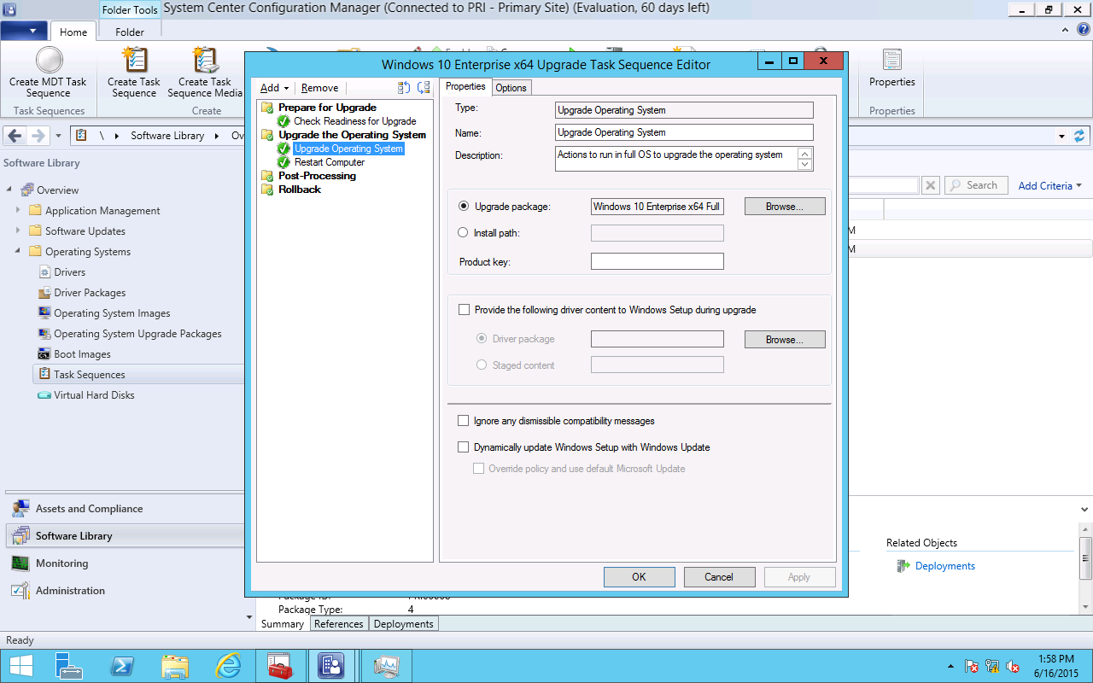
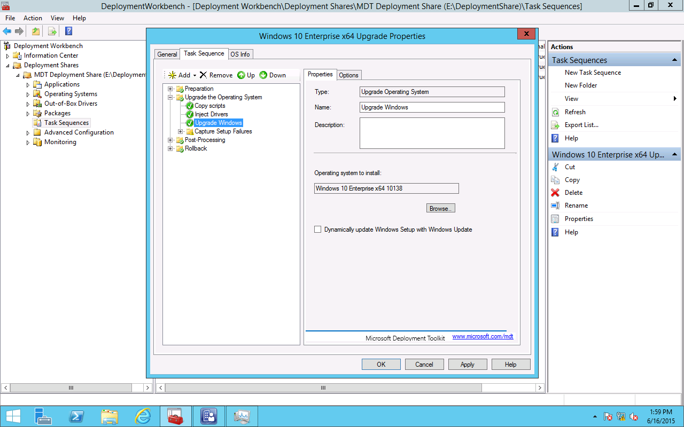
Moving In-place
MDT 2013 Update 2
SCCM 2016
Notes:
- One step CM v.next – entire task sequence on MDT (and know switch parameters) Review the new task sequence and also let them know that it can be used as a template for pre and post tasks
If we look at this from a task sequence side of things, we end up with a pretty simple task sequence and you’ll be able to do that in Config Manager vnext and with MDT 2013 Update 2. for Config Manager, there’s a sample they’ve published on the Config manager blog and you can use that with existing releases now, they just have a simpler version in vnext. The task sequence itself just needs to run some quick, simple validation checks, it then runs setup.exe to do the in place upgrade, and then afterwards, it does the additional cleanup steps that are necessary. So these almost become templates that don’t really do much beyond the upgrade itself but do provide the opportunity to put steps in place before the upgrade, ahead of time, or after the upgrade that maybe finalizes the process. For example, maybe they’re running an antivirus version that’s incompatible with windows 10. You could either upgrade it as a pre-step, or uninstall it as a pre step, do the upgrade, and then afterwards, install the supported versions to finish off the upgrade. Maybe they’d like to move to a different version of Office as part of the upgrade, so you can modify these task sequences to do that. You’d just need to put in the necessary pre and post steps to achieve whatever end point you’re looking for.

Slide 7
When not to use in-place upgrade?
Changing from Windows x86 to x64
Systems using Windows To Go, Boot from VHD
Changing from legacy BIOS to UEFI
Dual boot and multi-boot systems
Notes:
Highlight UEFI/Security/x64 There are some scenarios where in place upgrade won’t work. You can’t use it to change architecture so it has to be x64 to x64 or x86 to x86. You can’t use it with Windows to go, or boot from vhd. Those still basically require creating a new OS install. We did have some customers who deployed Windows 7 to UEFI machines that were logo’d for Windows 8 but they used the legacy bios emulation and now they’d like to change that back to UEFI, perhaps to take advantage of features like secure boot. In order to accomplish that they’d need to change the bios settings, re-partition the disk to have the necessary UEFI structure, change it from an MBR disk to a GPT disk and then change the operating system. And, unfortunately, there’s just not really a good or easy way to do that so they’ll need to continue running that legacy bios until the system is replace or they can certainly go ahead with a wipe and load scenario.
Dual boot and multiboot systems, unfortunately they are a bit complicated as well and we also don’t support that. It might work in some scenarios but you’d have to test that out as it might orphan some of those install and it’s just very tough to support that scenario.
Now some customers might think that they’re going to go the easy route and just take try to take their windows 8.1 image, upgrade it to windows 10, sysprep and capture it and be done. Unfortunately, that’s also not going to be possible as sysprep will be able to tell that an upgrade was run on the system and won’t run. So they’ll need to just build a new master image and hopefully this won’t be too big of a headache since over the years we’ve communicated that you should bring as much automation to bear on your image creation methodology and you should just be able to drop in the new Windows 10 media to your image factory, kick it off and it should just build it for you and capture it.

Slide 8
Upgrades using WSUS
To Upgrade to Anniversary Update (1607) using WSUS on Windows Server 2012 R2
Download and install KB 3159706 on Windows Server 2012 and Server 2012 R2
(Prepares WSUS to decrypt ESD Update Packages and installs KB 3095113 hot-fix to prevent database corruption)
Enable HTTP Activation in Server Manager Roles and Features
Update web.config to bind new service (Details in KB)
Notes:
Windows 10 feature updates (denoted by the “Upgrades” classification in WSUS) are staged in encrypted packages to Windows Update several days prior to the actual go-live date. This is to ensure that we can release to all regions simultaneously. The Windows 10 client has been able to decrypt these packages since RTM; however, WSUS was not able to do this. Until now, we have been manually decrypting these packages prior to releasing to the WSUS channel, the process of which is both time consuming and error prone. KB3159706 introduces this functionality to WSUS for Windows Server 2012 and Windows Server 2012 R2, such that it can now natively decrypt this content. Choosing not to apply this updates on a WSUS server means not being able to distribute the Windows 10 Anniversary Update, or any subsequent feature update, via these platforms. Note that Windows Server 2016 will have this functionality at RTM.
Post install requirements
Once update KB3159706 has been applied to a WSUS server the following steps must be completed for the update to work as expected.
1. Open an elevated Command Prompt window, and then run the following command (case sensitive, assume "C" as the system volume):
"C:\Program Files\Update Services\Tools\wsusutil.exe" postinstall /servicing
2. Select HTTP Activation under .NET Framework 4.5 Features in the Server Manager Add Roles and Features wizard.

Slide 9
Moving In-place lab Module 01-10: Perform an In-Place upgrade using MDT 2013 Update 2

Slide 10
Provisioning

Slide 11
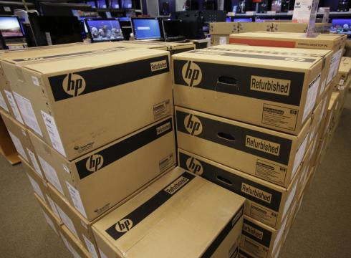
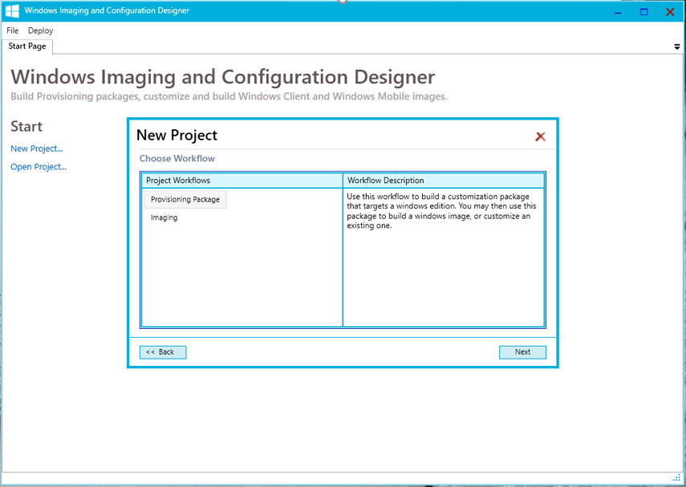
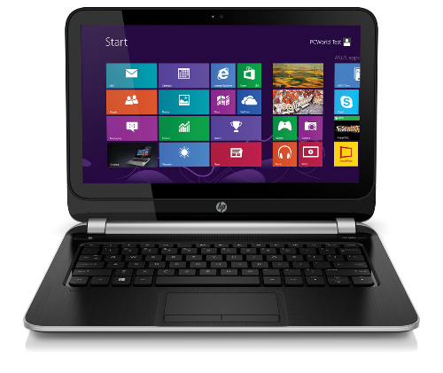
Provisioning, not reimaging (for new devices)
Take off-the-shelf hardware
Apply a provisioning package
Device is ready for productive use
Transform a Device
Flexible Methods
Enable the Enterprise SKU
Install apps and enterprise configuration
Enroll the device to be managed via MDM
Automatically trigger from the cloud or connection to a corporate network
Or initiate with NFC or QR codes
Or for manual distribution use media, USB tethering, or e-mail
Notes:
In-place upgrades are great for existing devices. But what about new ones? Today we know most organizations buy new devices, typically running a standard Windows Pro operating system – which contains all the needed drivers and configuration necessary for that device. But because it is difficult to configure that device for the organization’s needs, the first step is usually to wipe the system and deploy a standard organization image to the device. That adds an extra cost, as it can take 1-2 hours to do this.
We want to provide new tools to eliminate the wipe-and-load need. Instead, we want to be able to run through a simple provisioning process to transform the device into one that is ready for productive use. To do this, we want to enable a simple workflow:
Take a new device out of the box
Apply a provisioning package to it, turning it into a full-configured enterprise device
Once done, hand the device off to the end user who can immediately be productive
We will provide new tools to enable this, with the Windows Imaging and Configuration Designer to create these provisioning packages will all the necessary configuration steps included in them. Once created, we’ll provide a variety of ways to deploy these packages, from simple double-click operations to fully-automated solutions.
It’s also worth noting that this process will be exactly the same for Windows 10 phone devices. With these, wipe-and-load isn’t possible (they come preinstalled from the phone OEM), so this is a simple way to perform the initial configuration, without manually needing to set up each device.
[Note that this isn’t designed for ongoing management of the device; it’s just for the initial setup. These provisioning packages can be used to enroll the device into a management system, e.g. using Mobile Device Management, with that handling the ongoing configuration, app management, and more.]
That’s the process we envision: Transforming a device from its out-of-the-box state into a fully-configured enterprise device. We’ll provide flexible ways for doing this, some manual and some automated.
You can try this out today yourselves, as the Windows ICD tool is available in the Assessment and Deployment Kit for Windows 10 preview release, available on the Microsoft download center.

Slide 12
How it works
Windows Imaging and Configuration Designer creates a Provisioning Package
A package is a bundle of settings, profiles and file assets
Settings
Profiles
Assets
Provisioning Package (PPKG)
Asset binaries can be included in the package or referenced by URL
Notes:
Settings are simple policies – like minimal password length or disabling a camera
Profiles – Wi-Fi profile, VPN, Email
Assets are files required to make your configuration work, that includes wallpapers, certificates, applications, offline materials.

Slide 13
What can be Provisioned
Initial Setup
Edition Upgrade
Certificates
Connectivity Profiles
Management Enrollment
Universal Windows Apps
Win32 Applications
Scripts
Enterprise Policies
Offline content
Browser Settings
Start Menu Customization
Assigned Access
Notes:
Quite a few things. As you can see, many can be also provisioned through MDM but several capabilities are exclusive for provisioning.
One example would be

Slide 14



Under the Hood
MDM (Intune)
Provisioning
EAS
ConfigMgr
Service/Server
Device/OS
MDM Client
Provisioning Engine
EAS Client
WMI Bridge
Common Device Configurator
WMI providers
MDM Configuration Service Providers (CSP’s)
Notes:
Let’s take a look under the hood
Provisioning is using the same management surface that is exposed through Mobile Device Management + abilities exclusive used for provisioning
The key difference is that MDM interactive and the server can get feedback
Examples of configuration service providers

Slide 15
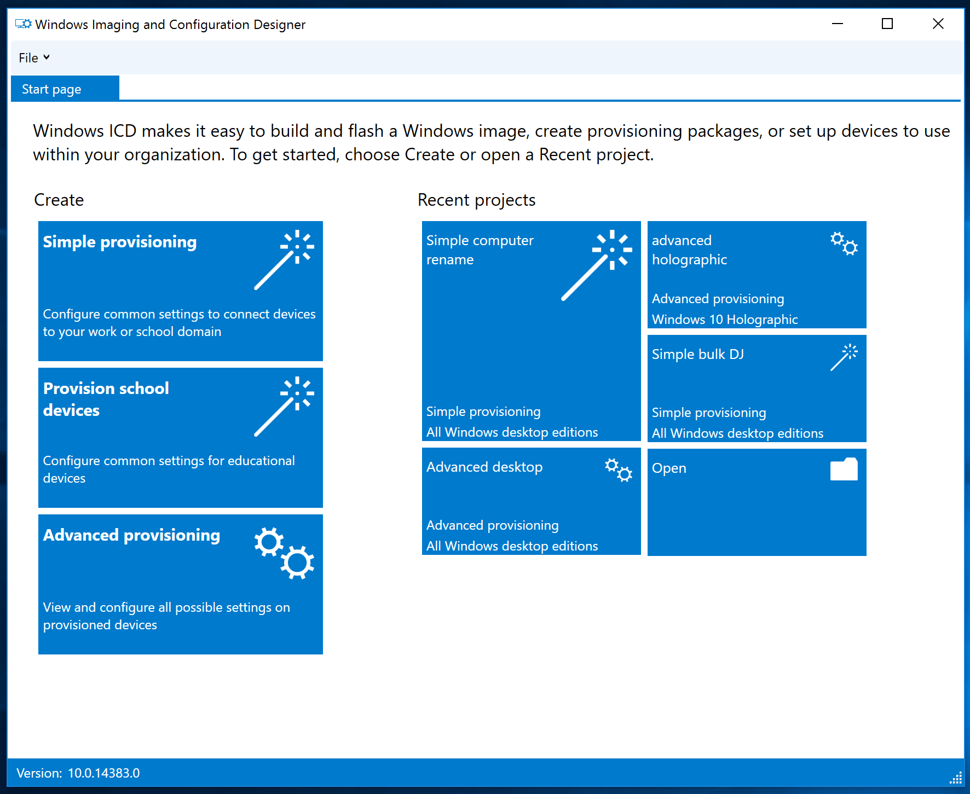
Windows ICD Updates for 1607
Simple Provisioning and School Device Provisioning workflows.
Simplified user interface

Slide 16
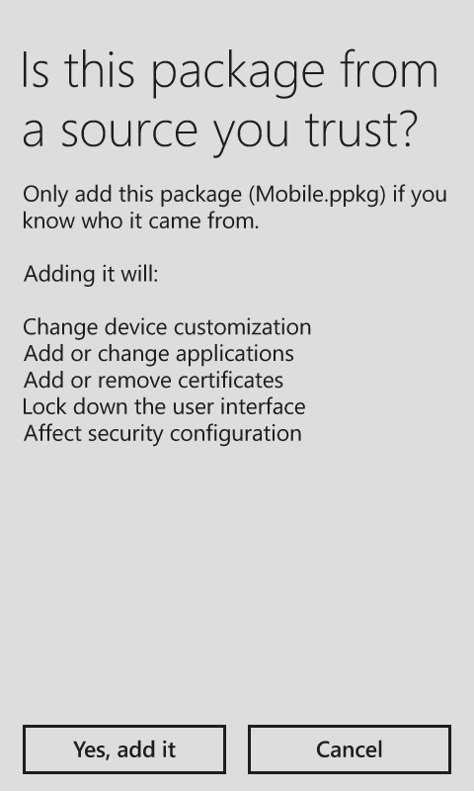
Security – Digital Signing
Security warning is shown when installing a package
Packages can be digitally signed
Signed packages are installed without security warning
You can set a policy to accept only signed packages

Slide 17
Provisioning lab Module 01-12: Use Windows Imaging and Configuration Designer (WICD) tool to customize an image

Slide 18
Wipe and Load

Slide 19
Traditional wipe and reload is still an option
Use Cases
Improvements
Updating multiple apps, or architecture at the same time as OS
Minimal application compatibility or driver issues change approach from application pre-test, to preview, pilot, then roll out in “rings”
Changing from BIOS to UEFI (Unified Extensible Firmware Interface) for Secure Boot, faster boot time, and ability to support extremely large drives
Upgrade Analytics Service uses telemetry data for device assessment, application inventory, utilization, compatibility validation, and roll-out wave planning
Devices with existing application issues (clean fresh environment – e.g. clean OS registry, wipe unused apps and temporary files)
Automation of deployment scripts in System Center Configuration Manager reduces IT installation and eliminates need to be on site at the device
Notes:
When we look at the breakdown of the traditional deployment project, we can see that it is composed of four major components:
Application testing and validation
The deployment process itself
Infrastructure updates
Image creation process
To reduce the overall effort, each one of these needs to be reduced by nearly an order of magnitude:
For apps, we need to reduce the number of apps that we test.
For infrastructure, we need to reduce the dependencies between Windows 10 and other infrastructure components, and in cases where these dependencies can’t be eliminated, make it easier to update the infrastructure.
For the deployment process, we need to shift from traditional wipe-and-load deployments to in-place upgrade.
And since we’re using in-place upgrade, we don’t need custom images at all.
Of course customers want proof that this can be done, and we’re working on customer case studies that explore this in greater detail. In the meantime, it’s worth noting that Microsoft’s own deployment took only a few weeks – see the IT showcase whitepaper for more information.

Slide 20
When to Wipe-and-Load
You can’t upgrade, service or provision a blank disk
Some scenarios don’t support upgrade
Clean start instead of factory image

Slide 21
Wipe-and-Load Components
Types
Administrator Initiated
User Initiated
OEM Pre-Installation
Scenarios
New Device
Refresh Device
Replace Device
Methods
Lite Touch Installation
Zero Touch Installation
User Driven Installation
OEM Installation
Offline Installation
Platforms
System Center 2016 Configuration Manager*
Microsoft Deployment Toolkit 2013 Update 2
Components
OS Image
Windows 10 1607 Assessment and Deployment Kit (ADK)
Image Answer File(s)
Windows Pre-installation Environment (Windows PE)
Windows Imaging & Configuration Designer (WICD)
User State Migration Tool (USMT)
Deployment Imaging Servicing & Management (DISM)
* Requires an update to fully support deployment methods.
Notes:
This slide shows the relationships between the components, Platforms, services (methods), and scenarios used in typical wipe-and-load deployments. Let’s take a little time to discuss the relationships between these elements and when you would use one or another in your deployments.

Slide 22
How to Wipe-and-Load
Start Windows 7 Windows 8 Windows 8.1
Capture data and settings
Remove existing OS
Install new OS image
Install apps
Restore data and settings
Finish Windows 10
USMT
DISM
USMT
Deployment Tools (MDT, System Center Configuration Manager)
Notes:
For those who have not been introduced, let’s take a look at the flow of a typical wipe-and-load deployment.
{Walk through and explain}

Slide 23
Other Considerations

Slide 24
Application Compatibility Testing Windows as a Service requires a new approach
Identify mission-critical applications and web sites
Focus testing effort on just these apps
Leverage internal flights for testing other applications and web sites
From initial pilot groups to large populations of users
Define groups to ensure broad hardware and software coverage prior to broad deployment
React to issues reported, remediate issues before expanding
Continue to pressure ISVs to adopt new model
It works vs. it is supported by the ISV
Notes:
Talk about how we are now recommending only test the absolutely missions critical applications
Deploy into pilot groups and react to issues that they identify rather than fixing everything before deployment
Refer back to the new rolling model of deployment where things are being evaluated on insider preview, tested in pilot groups with CB, and then widely distributed with CBB

Slide 25
Windows Upgrade Assessment Tools
Windows Upgrade Analytics
https://www.microsoft.com/en-us/WindowsForBusiness/upgrade-analytics
Ready for Windows
https://www.readyforwindows.com/
Notes:
The Windows Upgrade Analytics Service uses telemetry data to provide powerful upgrade readiness insights and recommendations about the computers, applications and drivers in your organization. This new service guides you through upgrade projects using a workflow based on Microsoft recommended practices. Up-to-date inventory data allows you to balance cost and risk in your upgrade projects.
The Ready for Windows Logo Program allows solution developers to register their products compliance with Windows 10 and receive a listing in the Ready for Windows 10 Directory. The Ready for Windows Directory not only lists supported ISV products, but offers additional resources for preparing for Windows 10 as well as a roadmap of “In Development”, Preview, and Released Windows 10 features.

Slide 26
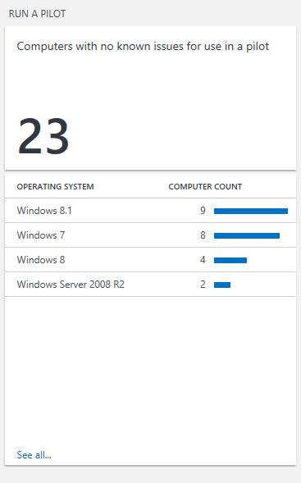
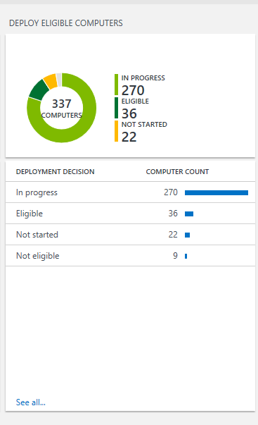
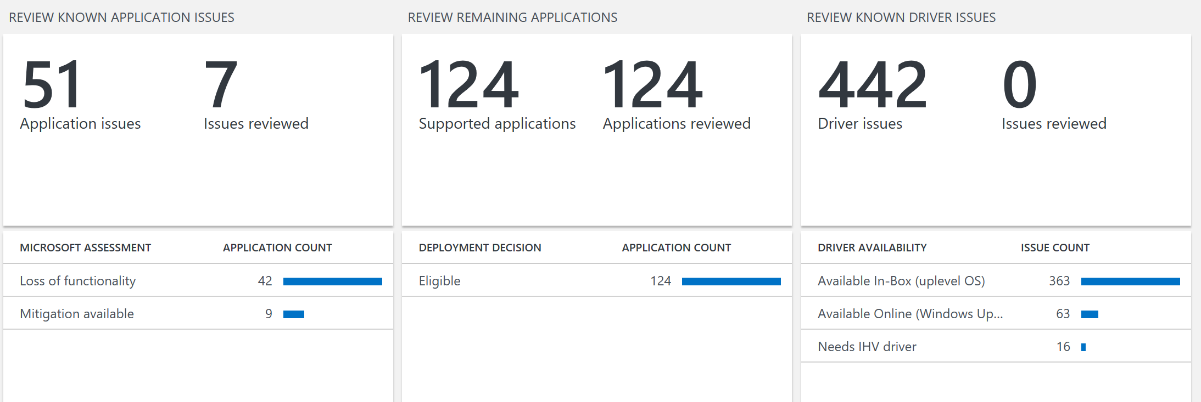
New Upgrade Analytics Service supports your management of Windows 10 and future upgrades
Free service from Microsoft
Uses “Tagged” telemetry feed from registered client site
Deployment dashboard
“Devices Ready to Deploy” Reports
Inventory reports: devices, drivers and applications
Device level app usage information
App and driver report – known issues to Microsoft
Deployment validation tool
Data export into management tools (e.g. SCCM)
Upgrade Analytics Service for Windows 10
Notes:
360 degree view into the organization device, driver and application inventory keeps you in control
Clear workflow visualization from pilot to deployment reduces complexity and risk
Data driven app rationalization tools reduce validation time and cost
Direct access to guidance and insights into compatibility issues known to Microsoft gives you help when you need it

Slide 27
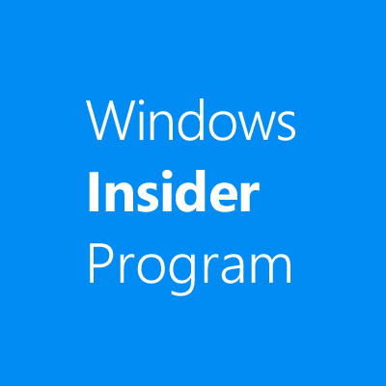

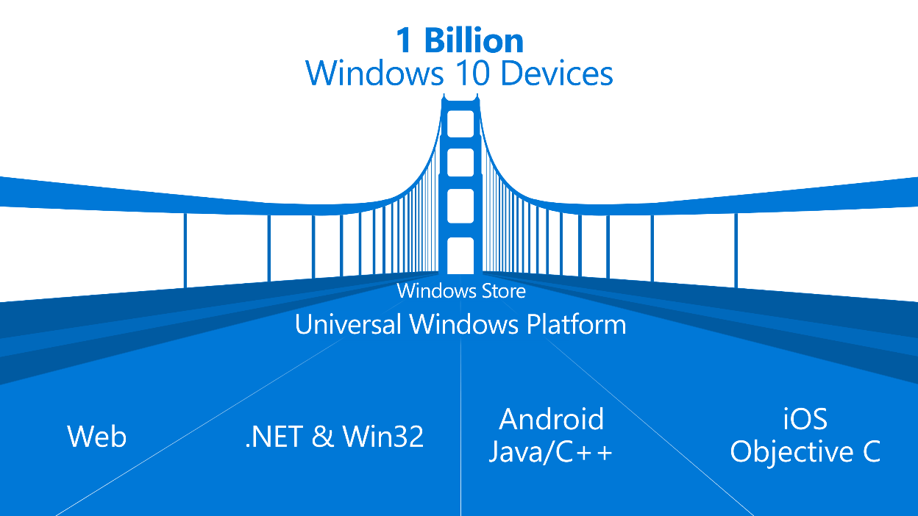
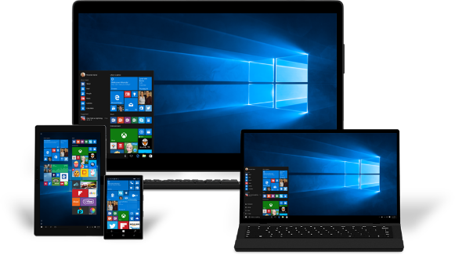

Ready for Windows program helps ISVs succeed with Windows 10 AND WaaS
Ready For Windows
WaaS Logo Program
Desktop Bridge
Cookbook
Join the Windows Insiders Program community to help shape the future of Windows, get early releases and more.
Leverage the Application Compatibility Cookbook for guidance in verifying compatibility of existing and planned apps. for Windows 10.
Get your application in front of Microsoft’s global Ready for Windows Directory for IT decision makers around the world.
Use the new Windows Compatible Logo in your marketing materials and websites to grow sales opportunities.
Use the Desktop Bridge to bring your existing desktop apps to the Universal Windows Platform
Download a preview build of the latest Windows SDK and Emulator to explore what's new in building apps. for Windows.
Download the Application Compatibility Cookbook for Windows 10.
Submit your compatible application to the Ready for Windows Directory.
Register for the Windows 10 Compatible Logo Program and assure your customers of quality and compatibility.
Download Desktop Application Converter to make your applications available in the Windows Store.
1
2
3
4
5
Notes:
Declare Support for Windows 10 and List Compatible Applications in Windows Directory
Drive global awareness and grow your business
Build customer confidence in quality of your applications
Gain valuable telemetry data for insights to customer usage patterns and app. behavior
Microsoft Ready for Windows Directory is a new web site that makes it easy for ISVs to list commercial applications that support Windows 10 and generate market visibility for their solutions.
All ISVs have to do is create a support statement for Windows 10 that we can link to on their web site, and complete a short application. Once reviewed and accepted by Microsoft, solutions will be listed in the directory for anyone looking for Windows software providers.
Ready for Windows will be heavily promoted to commercial customers world-wide on Microsoft web properties and through paid search, so ISVs can now reach a global market, generating leads to grow their business. And business customers will be able to search the directory for compatible apps and upgrade to Windows 10 with confidence knowing the business solutions they rely on are Windows ready today.
Partners can also benefit from using Windows 10 Compatible Logo to differentiate and promote the quality of their apps.
ISVs that issue a support statement for Windows 10 and Windows as a Service (WaaS) are granted (limited) usage rights to the Windows Compatible logo, helping them to build customer confidence and demand for their apps. by enhancing their marketing materials and websites.

Slide 28
Hydration
http://connect.microsoft.com/Accelerate

Slide 29
Why Hydration?
Microsoft BitLocker Administration and Monitoring (MBAM)
Microsoft Deployment Toolkit
SQL Server
Active Directory Certificate Services
Windows 10
Windows Assessment and Deployment Kit
System Center Operations Manager
User Experience Virtualization (UE-V)
DirectAccess
Office 365
System Center Virtual Machine Manager
Active Directory Domain Services
Application Virtualization (App-V)
DNS
Work Folders
DHCP
Web Application Proxy
System Center Configuration Manager
Active Directory Federation Services
Notes:
Windows 10 deployment and management lab kit
The Windows 10 Deployment and Management Lab Kit includes everything you need to review the new in-place upgrade option plus traditional deployment methods and other management tools. This free kit features:
A complete lab environment
The kit includes a pre-configured virtual lab environment with evaluation versions of:
Windows 10 Enterprise, version 1607 (Windows 10 Anniversary Update)
System Center 2012 Configuration Manager 1511 (including upgrade guidance to Configuration Manager 1606)
Windows Assessment and Deployment Kit for Windows 10, version 1607
Microsoft Deployment Toolkit 2013 Update 2
Microsoft Application Virtualization (App-V) 5.1
Microsoft BitLocker Administration and Monitoring (MBAM) 2.5 Service Pack 1
Windows Server 2012 R2
Step-by-step labs
Illustrated lab guides take you through multiple deployment and management scenarios, including:
Image creation
Lite-touch and zero touch deployment
Managing Windows 10 with Configuration Manager
Windows Information Protection
Code integrity
Windows 10 provisioning
In-place upgrade
Web application compatibility
Application virtualization
BitLocker Administration and Monitoring
Secure Host
Credential Guard
Windows Store for Business
Upgrade Analytics
https://technet.microsoft.com/en-us/windows/mt604890.aspx

Slide 30
Where is Hydration used?
Validate Design
Offering Activity
Train
Educate
Prep
✓ ✓ ✗
Delivery : Windows 10 PoC
✗ ✓ ✗
Delivery : Windows 10 Pilot
✗ ✗ ✓
Delivery : System Center Configuration Manager
✗ ✗ ✓

Slide 31
Hydration 1607
New
Changed
Deprecated
Updated PoC labs to support new products and features
Fixed lab issues
InfoPath Designer
Windows 10 1607
Windows 10 ADK 1607
MDT 2013 Update 2
Configuration Manager 1511 (can update to 1606)
MBAM 2.5 SP1
App-V 5.1

Slide 32
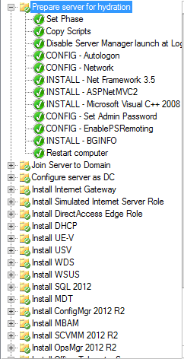
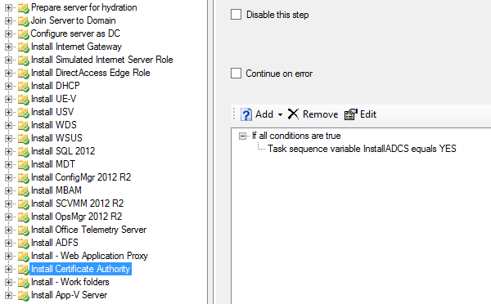
How Does Hydration Work?
PowerShell
Microsoft Deployment Toolkit
Dynamic Configuration

Slide 33
Hydration Lab Guide
Located at <hydration zip>\Guides\
Most of the common issues are resolved by reading through the Lab Guide first!

Slide 34

DRIVING CUSTOMER DEPLOYMENT – PROCESS GUIDANCE

Slide 35
Enterprise deployment process steps
1
2
3
4
5
Customer Targeting
Deployment Pitch
POC (Accelerate or Self Serve)
POC Conclusion (Pilot Buy-in)
Develop Deployment Plan and Pilot
Execute Pilot
6
Ongoing Windows-as-a-Service Management
Breadth Deployment Launch
Pilot Conclusion, and Green Light to Extend Deployment
Windows-as-a Service Support Discussion
Security Services Evaluation
11
10
9
8
7

Slide 36
Step 1 … Customer Targeting
1
2
Your Windows 7/8 Deployment Customers
Customers for whom you installed Windows 7/8, a few years ago, and are ready to take next step
Security And Compliance Driven Customers
Especially those with a recent security breach
3
4
Device Refresh Customers
Those that updated at XP end of life have machines ready to retire
LOB/Industry Mobility Scenarios
Where Windows 10/EMS features enable new capabilities e.g.
Mobile sales and service
Retail & kiosk
Secure collaboration beyond firewall
Band branch transformation

Slide 37

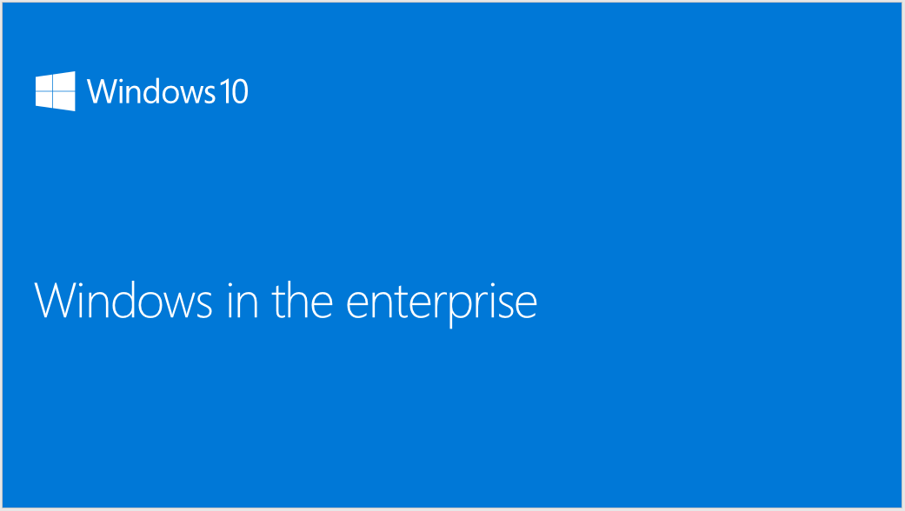

Step 2… Deployment Pitch
Schedule meeting with CIO, CFO/COO (or budget owner), Desktop IT management
Include Windows TSP or Windows BG lead
“Windows in the Enterprise” customer pitch deck
Objective is to get customer to agree to do a POC (either Microsoft funded through Windows Accelerate or Self-Service)
Windows in the Enterprise
This deck is intended as a high level business overview of Windows 10, both shipping features as well as future looking features, and is for 1 to 1 direct customer conversations only. You should not blog or publicly share the content broadly
https://microsoft.sharepoint.com/sites/infopedia/pages/layouts/kcdoc.aspx?k=G02KC-1-6496

Slide 38
Step 3… POC (Accelerate or Self-Serve)
Leverage Windows Accelerate funding (if customer qualifies) or use self serve materials
Show Windows 10 Enterprise functionality/value
Demonstrate In-Place Upgrade
Include Browser and Mobility POC
Validate key organization and LOB app compat
https://connect.microsoft.com/accelerate/
Self-Serve Delivery Materials
Files in Download
File Name | File Size | Download single file
Hydration 1604.zip | 104.21 MB | Download
Hydration 1604-ServerParent.zip | 5,790.27 MB | Download
Hydration 1604-ServerParentGen2.zip | 5,801.91 MB | Download
Hydration 1604-InclEvalSource.zip | 19,566.36 MB | Download
Windows 10 Enterprise PoC Sales and Delivery Materials.zip | 77.55 MB | Download
Windows 10 Enterprise Proof of Concept Scope
Day 1
Kickoff
Windows 10 overview
User experience demo
Deployment
In-Place Upgrade lab
Cloud service setup
Day 2
Management
Lab options
Cloud domain join
Provisioning
MGM
Windows store for Business
Windows as a service
Day 3
On premises lab setup
Lab image creation
Platform delivery lab
Day 4
Browser and app compat.
Identity and security
Lab options
Identity and security
Office 365
Day 5
Establish a vision for Windows 10 and Office based on the outcomes of the POC. Assessment and roadmap of get ready activities you can start now to prepare your infrastructure

Slide 39
Step 4… POC Conclusion (Pilot Buy-in)
Meet with key decision makers to validate POC results
Ensure customer sees the value of Windows 10
Identify any issues to resolve during pilot deployment
Show how partner can help support pilot deployment
Gain customer agreement to begin pilot deployment
POC Checklist
Provide hands on experience of Windows 10 Enterprise Deployment
Demonstrate In-Place Upgrade
Provision new PC out of box
Review intuitive UI with IT staff and small sample of users – to show minimal retraining required
Demonstrate new security and management features e.g. Windows Hello, Identity Protection, Windows Information Protection
Show browser and how to test application compatibility

Slide 40
Step 5… Develop Deployment Plan and Pilot
Select pilot PC groups as representative companywide workload sample
Leverage Upgrade Analytics Service telemetry data on application use and hardware capability in developing plan
Identify PCs for In-Place Upgrade, vs. those replaced in PC refresh with Provisioning
Build Provisioning package for New devices
Identify any PCs with business requirements for LTSB
Create first draft plan for company wide deployment waves
Wave 3 Deployment
Wave 2 Deployment
Wave 1 Deployment
Pilot
POC

Slide 41
Call to Action (…when you are going to deploy Win10)
GO TO READY FOR WINDOWS WEBSITE (ISV Directory)
Step 5…
1
Telemetry Sanity-Check (if an ISV solution works in Windows 10)
Provide by Microsoft. Go to ReadyForWindows (Directory Search)
Windows 10 Support Statement Check.
Provide by the ISV. Go to ReadyForWindows (Directory Search)
(If you are…) IT PRO
Publish your Support Statement at the Directory. Go to ReadyforWindows.
Telemetry Sanity-Check (if your ISV solution works in Windows 10)
Provide by Microsoft. Go to ReadyforWindows.
Join the Logo Program for Windows as a Service (WaaS). Support Statement needed around WaaS. Go to ReadyforWindows.
2
(If you are…) ISV
Understand if the Win 10 Enterprise blocker is an ISV App Compat blocker.
Get your Microsoft contact to use the escalation process tool:
(i.e. SSP, TSP, Services, PBEs, Technical Evangelist , etc.)
Internal tool www.Apps4Windows.com to escalate Windows 10 App
Compat blockers. (EPG and SMS&P).
Note: There is no specific SLA attached to the tool yet.
3
(If you are…) Windows Solution Partner
(SI)

Slide 42
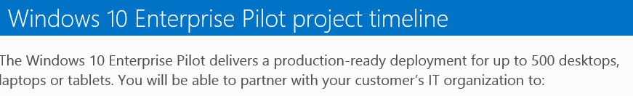
Step 6… Execute Pilot
Leverage Windows Accelerate funding if customer qualifies
Get materials from Accelerate website https://connect.microsoft.com/accelerate/content/content.aspx?ContentID=31991&IsDraft=False
Design for 500 seat deployment
Include Windows 10 Enterprise Compatibility Briefing and Security Integration Briefing
ASSESS
REMEDIATE
ENABLE
MIGRATE
Envision
Plan
Plan
Build
Build
Stabilize
DEPLOY
Requirement Workshops, Agreement on Solution
2 Weeks
2 Weeks
4 Weeks
2 Weeks
Core Infrastructure, Designs and Lab
Pilot Deployment
Full Production Pilot Deployment & Windows as a Service Preparations
The Windows 10 Enterprise Pilot delivers a production-ready deployment for up to 500 desktops, laptops or tablets. You will be able to partner with your customer’s IT organization to:
Conduct planning and architecture design workshops
Application deployment
Image engineering
Configure In-Place Upgrade, Lite and/or Zero Touch Installations

Slide 43

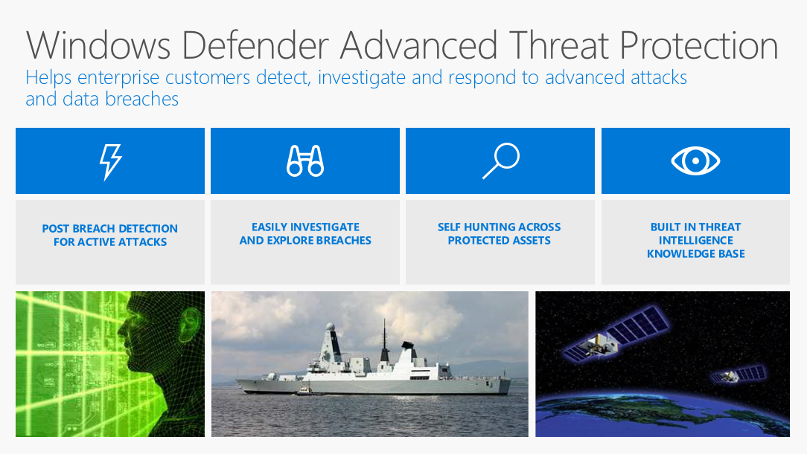
Step 7… Security Services Evaluation
Demonstrate value of Windows Defender Advanced Threat Protection (ATP) using To Customer deck
Leverage Pitch Perfect Secure Learning Path https://mspartnerlp.partner.microsoft.com/LearningPath/LearningPath/DLPaths?trackId=1717&rowId=2326&trackPathId=14432
Support customer implementation or offer as a service Windows/SPE security capabilities e.g.:
Windows Information Protection,
Device Guard
Multi –Factor Authentication
Office 365 security
EMS security/Azure AD/Identity Management
Offer IT Security Service to respond to threats or incidents
Get trained on ATP and other security capabilities (consider Premier Support for Partners as backup)

Slide 44
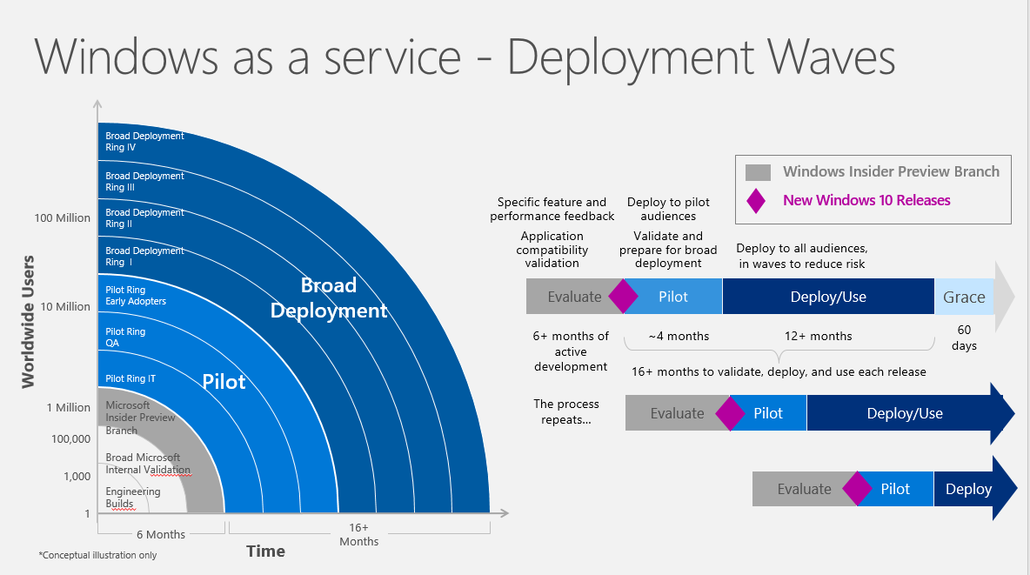
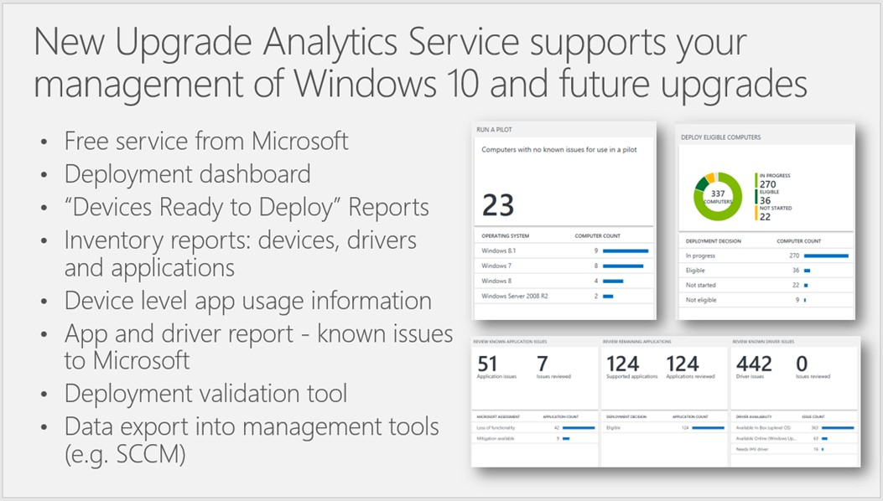
Step 8… Windows-as-a-Service Support Discussion
Monetize WaaS including:
Desktop Management
Helpdesk
Identity Management
Hardware support break/fix
Specify customer environment to simulate to use Windows Insider Preview to test future updates in Current Business Branch
Consider offering Test-as-a-Service for critical custom LOB apps
Leverage Upgrade Analytics Service tool to support upgrade wave deployments

Slide 45
Step 9… Pilot Conclusion and Green Light to Extend Deployment
Validate application and systems capability
Ensure full range of customer scenarios have been tested successfully
Prove efficient deployment models
Gather user feedback and productivity data
Adapt customer deployment plans as needed
Agree to begin companywide deployment
Pilot Checklist
Deploy Windows 10 Enterprise in Production Environment Targeting 500 Seats
1 Primary Location, 1 Branch Location
Current Branch for Business
Group Policy Starter – Management Environment
Servicing Environment (WaaS)
Application Delivery
Platform Delivery – Deployment Environment (Zero Touch, In Place Upgrade, Lite Touch)
Image Creation

Slide 46


Step 10… Breadth Deployment Launch
Plan scaled deployment in organizational waves (e.g. by Geo or functional area)
Assess network load considerations
Support customer change management, project planning, and employee communications
Schedule customer and partner resources to support
Launch automated deployment
Management Tools
Upgrade Analytics

Slide 47
Step 11 – Post Deployment… Ongoing Windows-as-a-Service Management
Define strategy, and timing for next/ongoing upgrade management
Build customer environment for Windows Insider Preview
Test upcoming updates in Current Business Branch
Load and simulate critical custom LOB apps for Test-as-a-Service
Begin next cycle of Windows upgrade deployments
Deployment of Windows 10 Releases Over Time
Specific feature and performance feedback
Application compatibility validation
Deploy to pilot audiences
Validate and prepare for broad deployment
Deploy to all audiences, in waves to reduce risk
Evaluate
Pilot
(CB)
Deploy/Use (CBB)
Grace
6+ months of active development
~4 months
12+ months
60 days
16+ months to validate, deploy, and use each release
The process repeats…
Evaluate
Pilot
(CB)
Deploy/Use (CBB)
Evaluate
Pilot
(CB)
Deploy/Use
(CBB)
Windows Insider Preview Branch
New Windows 10 Releases
Only 2 CBB versions in active support at one time

Slide 48

Next steps for you to win with Windows 10
Leverage your internal use rights to adopt Windows 10 Enterprise—using it is the best way to sell it
Get training and other resources available on MPN Windows
Enroll in a Windows Tech Series Training Event
Leverage Windows Accelerate to extend POCs & Pilots
Prioritize Customer Targets for New POCs and Pilots
Early Windows 7 Adopters with device renewal needs
Security motivated customers
Build a Managed Services Business model into your offerings
Capture the service revenues that build on Windows 10 Enterprise

Slide 50


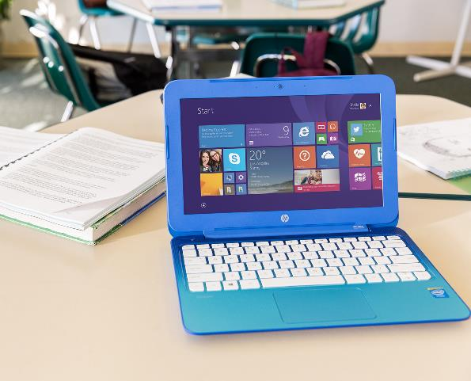
PARTNER REVENUE OPPORTUNITY DETAIL
Notes:
PROFITABILITY We get it. Windows 10 is well-received by businesses, and it’s really important to enable our Cloud Services Business. Now tell us about the CASH $$!!

Slide 51



Windows 10 is your foundation for services revenue
PARTNER MANAGED RECURRING REVENUE IS PRIMARY GROWTH DRIVER
IP AND NEW INDUSTRY/ FUNCTION SCENARIOS PROJECTS
Windows 10 momentum/ customer interest
Device renewal
OFFICE 365, EMS, AZURE AD, IMPLEMENTATION AND RECURRING REVENUE
30–40% project margin
40–60% IP margin
MANAGED SERVICE (DESKTOP+) MONTHLY RECURRING REVENUE
30–40% margin
NEW WINDOWS PROJECTS, SECURITY, LIFECYCLE MANAGEMENT
DEVICES & ACCESSORIES HW/SW RESALE
40–50% margin
Windows 10 momentum/ customer interest
POC, PILOT, SCCM PREP & DEPLOYMENT PROJECTS
30–40% margin
“Windows 10 unlocks cloud profitability. Without Windows 10 we won’t have a successful cloud business”
CHRIS HERTZ – FOUNDER
5–15% margin
20–30% margin bundled as monthly managed service
20–30% margin
PARTNER REVENUE BUILT ON WINDOWS 10

Slide 52
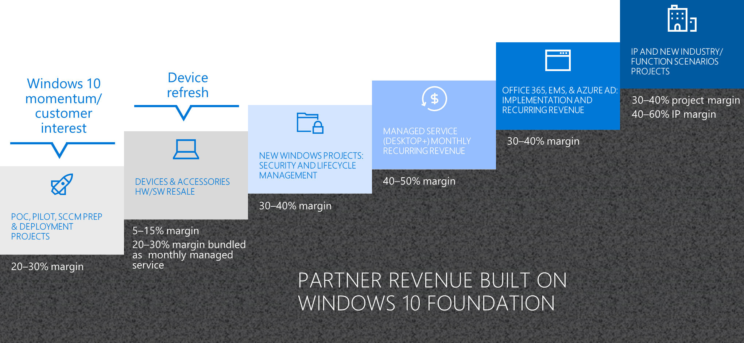

Partner revenue… POC, Pilot, SCCM Prep and Deployment Projects
Windows 10 momentum/ customer interest
Windows 10 is an easy conversation starter. Massive migration already, +350M devices on Windows 10!
Windows 7 and Windows 8 customers, will want to migrate for better security features in Windows 10
POCs and Pilots will demonstrate ease of migration + device and application compatibility. (Funding available via Windows Accelerate for qualifying customers)
Before customers can move to Window 10, larger customers will need the Nov 2015 updated version of SCCM (more partner revenue).
While deployment is automated, easier and faster, customers still need your expertise
New deployment approach and choices
New licensing options
Upgrade Analytics Service device assessment and pilot waves
Expertise in automated deployment, provisioning scripts, network load
Program/Change management
Because deployments are faster and easier, consider up-sell, cross-sell, and new customer opportunities
POC, PILOT, SCCM PREP & DEPLOYMENT PROJECTS
20–30% margin

Slide 53
Partner revenue… POC, Pilot, SCCM Prep and Deployment Projects
Windows 10 momentum/ customer interest
POC, PILOT, SCCM PREP & DEPLOYMENT PROJECTS
20–30% margin
Note: Revenue and margin values are based on partner interviews, and will vary by partner, geography, and local market conditions.

Slide 54
Partner revenue… Device and Accessories HW/SW sale
Device refresh
Device Refresh is another great opportunity to engage customers around Windows 10 deployment
Aging devices purchased for the XP End of Support wave are now due for refresh
Intel estimates 400M devices more than 4 years old, ready for refresh
New devices and form factors do so much more and take advantage of new Windows 10 features
Windows Hello, Pen & Ink, Touch-Screen, Light-Weight, Longer Battery, etc…
Windows 10 Pro Devices typically have a high gross sales value, which more than makes up for the smaller margins associated
Partners we have talked to typically captured higher total sales margins of 20-30% in small and mid-market customers by bundling premium devices, break-fix, and warranty as part of a managed services package - e.g. $50/month for a Surface Book
Distributor & OEM financing packages minimize the capital investment for partners and customers
DEVICES & ACCESSORIES HW/SW RESALE
5–15% margin
20–30% margin bundled as monthly managed service

Slide 55
Partner revenue… Device and Accessories HW/SW sale
Device refresh
DEVICES & ACCESSORIES HW/SW RESALE
5–15% margin
20–30% margin bundled as monthly managed service
Note: Revenue and margin values are based on partner interviews, and will vary by partner, geography, and local market conditions.

Slide 56
Partner revenue… New Windows Projects: Security, and Lifecycle Management
New Feature Implementations: Windows capabilities and security features allow customers to do more – and your support in implementation of these features adds high value
Data Protection
Passport For Work
Device Guard
Multi-Factor Authentication
Security Management Service: Security is a high concern for all commercial customers today. Experts say there are 2 types of company today: 1) Those who have been hacked, and 2) Those who don’t know they have been hacked.
Windows Defender Advanced Threat Protection
Incident Response Services (Threat Elimination, Breach Assessment, Repair / Prevention)
O365 Security + EMS Security Integration
Lifecycle Management: Windows as a Service, offers opportunities for you to manage patches, and pilot/roll-out of new feature updates on customer applications, networks, PCs and Mobile devices
NEW WINDOWS PROJECTS: SECURITY AND LIFECYCLE MANAGEMENT
30–40% margin

Slide 57
Partner revenue… New Windows Projects: Security, and Lifecycle Management
NEW WINDOWS PROJECTS: SECURITY AND LIFECYCLE MANAGEMENT
30–40% margin
Note: Revenue and margin values are based on partner interviews, and will vary by partner, geography, and local market conditions.

Slide 58
Partner revenue… Managed Service (Desktop+) as Monthly Recurring Revenue
Commercial customers are turning to trusted Partners to manage their Desktop Services on a monthly recurring revenue model
Network / Desktop / Application Configuration
Device Management (Patching, Upgrades, Device Refresh, Device Configuration)
Help-Desk Support (1st Level Software + Systems Support)
Break-Fix (2nd Level Root-Cause Analysis, Hardware Support)
Identity Management
Successful partners are shifting their business model to prioritize Managed Desktop Services and support the customer demand
Attractive margins of 40-50% (some as high as 60%) are reported as standardizing on Windows 10 lowers the cost of providing these services
Banks are willing to lend more to fund growth once recurring revenues make up the majority of the business revenue stream
MANAGED SERVICE (DESKTOP+) MONTHLY RECURRING REVENUE
40–50% margin

Slide 59
Partner revenue… Managed Service (Desktop+) as Monthly Recurring Revenue
MANAGED SERVICE (DESKTOP+) MONTHLY RECURRING REVENUE
40–50% margin
Note: Revenue and margin values are based on partner interviews, and will vary by partner, geography, and local market conditions.

Slide 60
Partner revenue… Office 365, EMS and Azure AD: Implementation and Recurring Revenues
Windows 10 Enterprise paves the way to sell other service offerings in an age of digital transformation:
Office 365
EMS / Azure AD (e.g. identity management services)
These services can be bundled as part of a larger offering, increasing the total service revenue per user per month.
Implementation can be billed separately or factored into the monthly recurring revenue (with a minimum commitment duration)
OFFICE 365, EMS, AZURE AD: IMPLEMENTATION AND RECURRING REVENUE
30–40% margin

Slide 61
Partner revenue… Office 365, EMS and Azure AD: Implementation and Recurring Revenues
OFFICE 365, EMS, AZURE AD: IMPLEMENTATION AND RECURRING REVENUE
30–40% margin
Notes: Revenue and margin values are based on partner interviews, and will vary by partner, geography, and local market conditions.
Software Pricing Levels will vary by customer size, licensing model, and geography.

Slide 62
Partner revenue… IP and New Industry Function Scenario Projects
Custom development work can also be leveraged across multiple customers (and included in recurring revenue) – often this reflects industry or functional expertise
Software/Cloud interfaces
Templates
Custom software
The digital transformation, security, portability, and new form factors enabled by Windows 10 open a host of new industry or function specific scenarios – e.g. new forms of customer interaction, kiosk solutions, mobile check-out, selling scenarios. These can lead to major partner development and implementation opportunities
IP AND NEW INDUSTRY/ FUNCTION SCENARIOS PROJECTS
30–40% project margin
40–60% IP margin

Slide 63
Partner revenue… IP and New Industry Function Scenario Projects
IP AND NEW INDUSTRY/ FUNCTION SCENARIOS PROJECTS
30–40% project margin
40–60% IP margin
Note: Revenue and margin values are based on partner interviews, and will vary by partner, geography, and local market conditions.

Slide 64
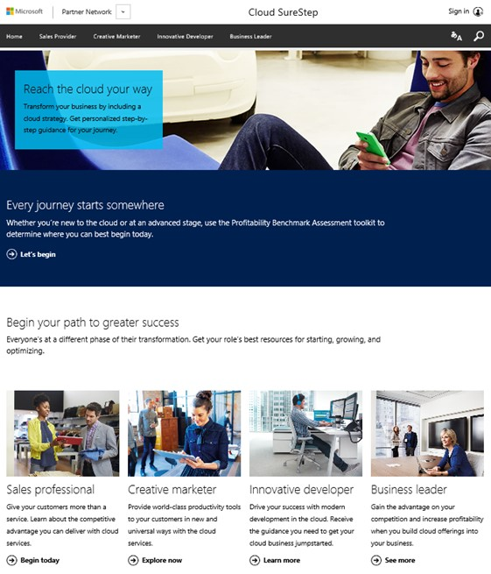
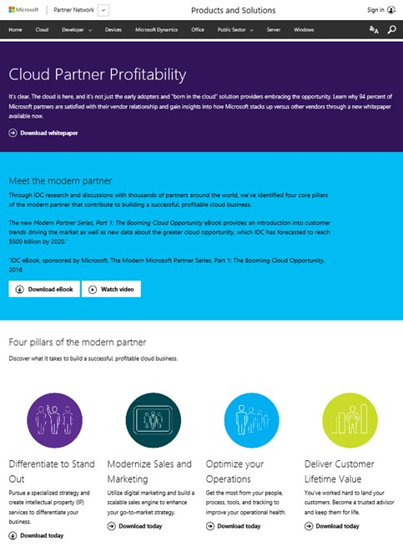
Partner transformation and profitability resources:
https://partner.microsoft.com/en-US/SureStep
https://partner.microsoft.com/en-us/solutions/cloud-partner-profitability

Slide 65



PROGRAMS TO DRIVE PARTNER SUCCESS
Notes:
What programs and investments is Microsoft making to help you be successful selling Windows 10 next year? A lot! Let’s talk about them…

Slide 66
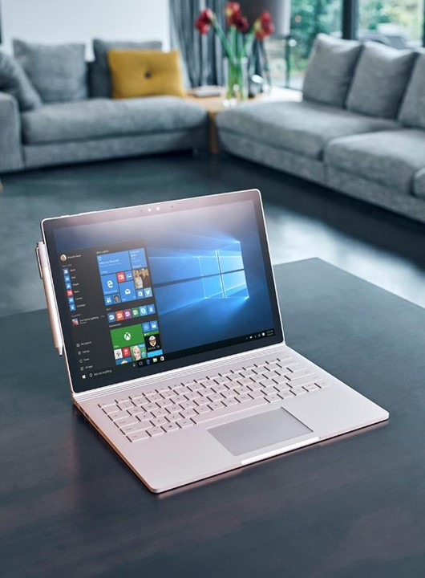
Many Windows FY17 partner programs and initiatives
TYPE | PROGRAMS & INITIATIVES
Events | Accelerate Your Business events (customer events)
 | Device Days events (partner events)
 | Tech-series training events (in-person and online)
Customer Acceleration | Windows Accelerate Program
 | Windows and Office FastTrack Program
 | EMS FastTrack Program
 | Application Compatibility
Incentives | OEM ProWins partner incentive
 | Partner Discounts, Internal Use Rights
 | Windows Defender ATP rebate offer (to-customer)
Contact your Microsoft Account Manager for more information on any of these programs / initiatives

Slide 67




Accelerate Your Business adds marketing support
OBJECTIVES
Drive small business customer interest in Windows 10 Pro, new form factors and accelerate Pro device refresh
Showcase new productivity technologies, security tools and form factors
Support OEM partners through PR and media coverage
PROGRAM EXECUTION COMPONENTS
IN PERSON EVENTS
DIGITAL MEDIA & ONLINE CUSTOMER EXPERIENCE
PR & MEDIA
DEVICE OFFER & CONVERSION
CHANNEL AMPLIFICATION
Delivering rich content, small business panels, keynote speakers and device experience
Paid Media & Social Customer impressions delivering Windows 10 Pro Value Prop for SMBs
Driving new stories and editorials for new WIn10 Pro Devices
Providing small business leads to Partners and Resellers
Reseller Demand Generation
& Readiness
250K Customer Engagements
1B Impressions
250+ Press Coverage
150k Referrals to OEMs
15k Sellers Trained
TARGET GOALS
Notes:
Always on global execution program to nurture new device purchases integrated with “Accelerate your business” customer journey

Slide 68
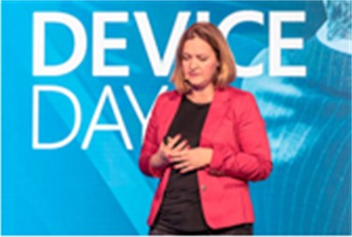
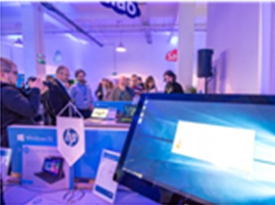
Device Days Plus, the sales training you need Train resellers on selling Windows 10 Pro devices and how to increase attach rate
AUDIENCE
Top to mid-tier resellers sales teams selling to SMB/CA space
LIVE EVENT MATERIALS & SPONSORSHIP
Event-in-a-box materials: Registration website, main presentation deck, demo script, videos, event invite templates, signage design, event hand-outs, eval forms.
Sponsorships: OEM Partner booth and break out sessions for Silver and Gold sponsors
Special Incentive Program or Eval units for attendees only
EVENT AGENDA
Windows across devices, Pro right licensing
Industries and scenarios, testimonial videos
Device demos, compete, objection handling
Cross-selling the stack– Office, Servers
Resources to help drive sales and offers
30-minute break-out session for Gold Sponsors
Microsoft Kiosk to showcase Windows 10 Pro hero devices -> Phone continuum, CTE, IOT
DIGITAL DEVICE DAY ONLINE MODULES
English recorded version delivered in 5-10 minute segments
Online delivery through the Device Partner Center online training engine
WHEN, WHERE, HOW
August to June
120 live Training Events Worldwide, reaching over 10,000 resellers
10 Online-modules for Further Scale

Slide 69
Windows Partner Tech-Series Program, FY17 End-to-end experience (consumption path)
Goal: 6000 Partners Trained in FY17
SELF-SERVE DIGITAL
PARTNER UNIVERSITY
1:M ONSITE
TARGETED
RSC/RTC
PLANNED
CALLDOWNS
WINDOWS 10
1:1 WINDOWS WORKSHOP
1:1
DEPLOYMENT SHADOWING
“Provide me with some self-consumption content around Windows and help me obtain the competency”
“Help identified Partners understand their options and choose the right technology focus area(s) for their needs”
“Help me understand the next options I have to increase my knowledge”
“Help me build my Windows Practice…”
“Help me with my first Windows deployment(s)”
WINDOWS & DEVICES COMPETENCY
SUBSIDIARY IDENTIFIED
SUBSIDIARY NOMINATED WINDOWS PARTNERS
LINK
Notes:
Self-Serve Digital: Partner U with built in Assessment
Planned Call downs: RSC (managed partners) / RTC (unmanaged partners)
After attending an event (remote or onsite), Partner is encouraged to then complete the Windows & Devices competency

Slide 70
Windows Accelerate puts Windows 10 Enterprise in customers’ hands to drive adoption
OVER 2,500 ENGAGEMENTS
IN FY16
CUSTOMER ENGAGEMENT OPPORTUNITY
PROJECT GUIDANCE AND IP PROVIDED BY MICROSOFT
FUNDING TO DELIVER ENGAGEMENT PROVIDED BY MICROSOFT
ENTRYWAY TO ADDITIONAL SERVICE REVENUE OPPORTUNITIES
DEPLOYMENT
SOLUTION
5+ DAY
2–3 DAY
10 DAY
WINDOWS 10 ENTERPRISE POC
BROWSER MIGRATION POC
WINDOWS 10 MOBILITY POC
30–50 DAY
4 DAY
Q1 FY17
NEW
2–4 DAY
Q1 FY17
NEW
WINDOWS 10 ENTERPRISE PILOT
WINDOWS 10 ENTERPRISE COMPATIBILITY BRIEFING
WINDOWS 10 ENTERPRISE SECURITY INTEGRATION BRIEFING
Proof-of-Concept (PoC) takes place in a test environment at the customer location, delivered by MCS or MS certified SI Partners.
Production Pilot takes place in a production environment at the customer location, delivered by MCS or MS certified SI Partners.
https://partner.microsoft.com/en-US/Solutions/windows-accelerate
Notes:
Windows 10 Enterprise Compatibility Briefing: Aimed at removing the key deployment blocker around App Compatibility while also accelerating the speed of deployment especially among the large enterprise accounts.
Windows 10 Enterprise Security Integration Briefing: Security is a key value driver for Windows 10 and offers a clear and compelling reason for customers to deploy. Features such as Windows Defender ATP, Windows Information Protection and Credential Guard will be included.

Slide 71

Microsoft FastTrack for Windows 10 and Office 365 Pro Plus
ONBOARD
ENVISION
DEFINE VISION & DEPLOYMENT PLAN FOR A SUCCESSFUL ROLLOUT
MOVE TO WINDOWS 10 & OFFICE 365 ProPlus, SMOOTHLY AND WITH CONFIDENCE
FastTrack
DRIVE VALUE
METHODOLOGY & RESOURCES
PARTNER SERVICES
TOOLS & INSIGHTS
Customer Benefits
Reliable deployments at less risk
Realize business value faster
Maximize Microsoft investment
FastTrack.microsoft.com
Partner Benefits
Qualified deployment leads
Leverage deployment offers
Lead deployment engagements
CUSTOMER | PARTNER
LINK
BOOST USER ENGAGEMENT AND MANAGE CHANGE
Notes:
Launching for H2.

Slide 72
Ready for Windows program helps ISVs succeed with Windows 10 AND WaaS
Ready For Windows
WaaS Logo Program
Desktop Bridge
Cookbook
Join the Windows Insiders Program community to help shape the future of Windows, get early releases and more.
Leverage the Application Compatibility Cookbook for guidance in verifying compatibility of existing and planned apps. for Windows 10.
Get your application in front of Microsoft’s global Ready for Windows Directory for IT decision makers around the world.
Use the new Windows Compatible Logo in your marketing materials and websites to grow sales opportunities.
Use the Desktop Bridge to bring your existing desktop apps to the Universal Windows Platform
Download a preview build of the latest Windows SDK and Emulator to explore what's new in building apps. for Windows.
Download the Application Compatibility Cookbook for Windows 10.
Submit your compatible application to the Ready for Windows Directory.
Register for the Windows 10 Compatible Logo Program and assure your customers of quality and compatibility.
Download Desktop Application Converter to make your applications available in the Windows Store.
1
2
3
4
5
Notes:
Declare Support for Windows 10 and List Compatible Applications in Windows Directory
Drive global awareness and grow your business
Build customer confidence in quality of your applications
Gain valuable telemetry data for insights to customer usage patterns and app. behavior
Microsoft Ready for Windows Directory is a new web site that makes it easy for ISVs to list commercial applications that support Windows 10 and generate market visibility for their solutions.
All ISVs have to do is create a support statement for Windows 10 that we can link to on their web site, and complete a short application. Once reviewed and accepted by Microsoft, solutions will be listed in the directory for anyone looking for Windows software providers.
Ready for Windows will be heavily promoted to commercial customers world-wide on Microsoft web properties and through paid search, so ISVs can now reach a global market, generating leads to grow their business. And business customers will be able to search the directory for compatible apps and upgrade to Windows 10 with confidence knowing the business solutions they rely on are Windows ready today.
Partners can also benefit from using Windows 10 Compatible Logo to differentiate and promote the quality of their apps.
ISVs that issue a support statement for Windows 10 and Windows as a Service (WaaS) are granted (limited) usage rights to the Windows Compatible logo, helping them to build customer confidence and demand for their apps. by enhancing their marketing materials and websites.

Slide 73
ProWins program adds device incentives and support
ProWins Channel incentive design to incentivize sales of commercial devices with Windows Pro
ProWins Per Unit Incentive
ProWins Accelerator
ProWins CMI
PROGRAM
DETAILS
Disti and Reseller payment for all Windows Pro devices sold*
Marketing and training funds to grow Pro devices sales**
Up to $25 per hero device, for commercial marketing investment*
GOALS
Mix Shift To Commercial/Pro
Sell-through Growth
$15M
$5M
$25M
$25M
LINK
*Based on Disti reporting data
**Select Distributors and Resellers only

Slide 74
Get proactive security with the Windows Defender ATP Customer Rebate Offer
WINDOWS DEFENDER ATP REBATE OFFER
BUY | Purchase a minimum of 500 seats of Windows Defender ATP between August 1, 2016 and December 31, 2016
GET | Receive 6 month rebate on Windows Defender ATP (up to a maximum of 10,000 seats)
DEPLOY | Must deploy a minimum 500 devices on Windows 10 Anniversary Update by 6/30/2017
ASK | Customers asked to provide updated plan to deploy at least 10% of installed base on Windows 10 (not condition of rebate)
Offer Excludes phone, IoT, server, and virtual machines.
Notes:
Targets: All EPG & CAM/CTM commercial & PS accounts with new/existing EA or Select agreements.
VL Discount: Normal WDATP pricing with empowerment may be used as part of WDATP negotiation.
Rebate Availability: Customers must purchase WDATP and then register for the WDATP rebate online. Only one rebate claim per customer. Account teams requested to have an updated deployment plan loaded in CET showing the customers commitment to deploy 10% of PCIB by 6/30/17 (not a condition of rebate).
Rebate Payment Date: Coupon code must be issued during Offer Term but payment will only be made once the minimum 500 Windows devices have been deployed on or before 6/30/17. Rebate will be paid directly to customer. Rebate will be calculated as the first 6months cost of the already paid WDATP amount and paid in USD currency within 90 days.
Terms & Conditions: Please refer terms & conditions sheet for more details.

Slide 75
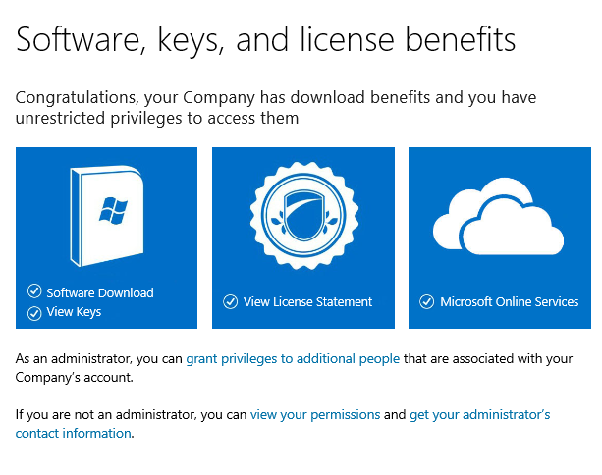
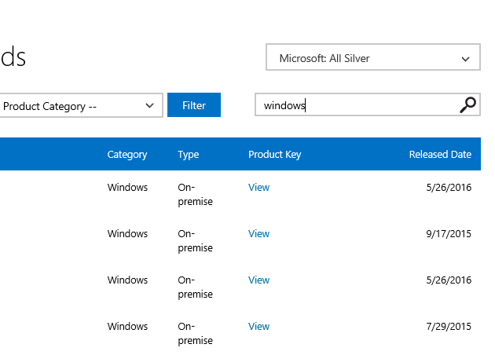
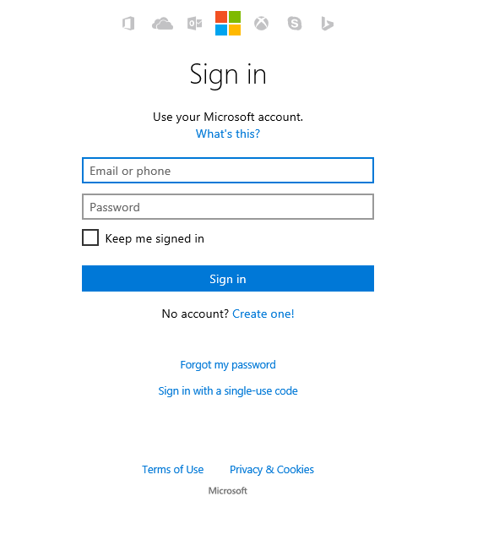
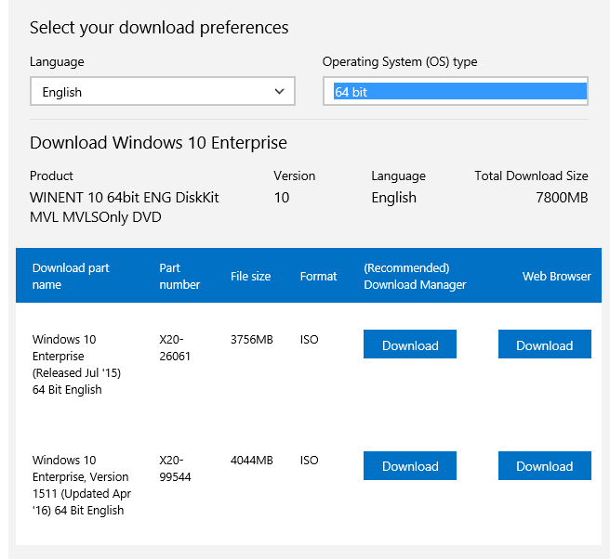
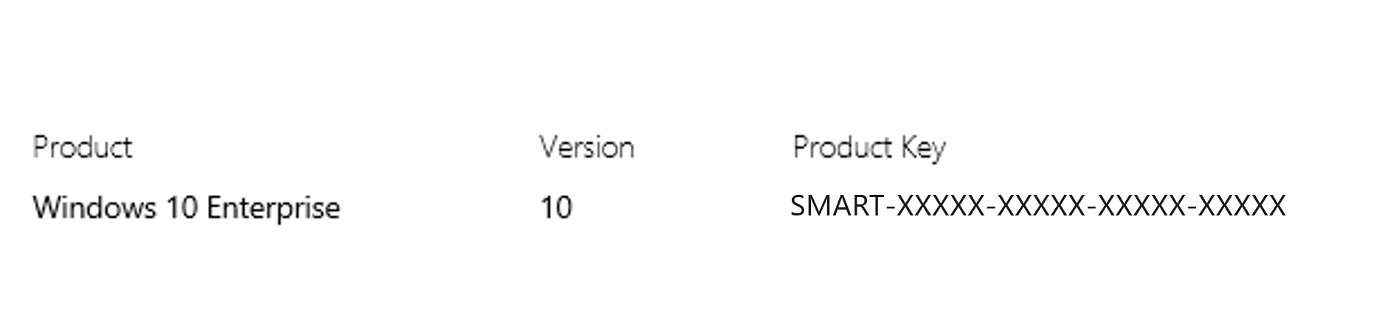
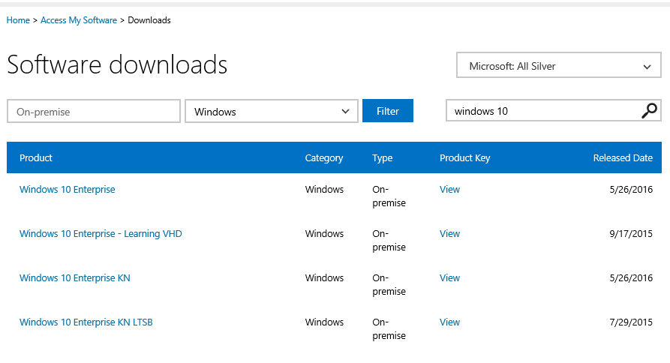
Start using Windows 10 – Six steps to activate Internal Use Rights
Go to the Partner Digital Download Portal http://aka.ms/activateIUR and sign in with your Microsoft Account with admin right (formerly Windows Live ID)
2. Click at the first tile (Software Download)
3. Search for “Windows 10” in the search bar.
Choose the Windows 10 edition you would like to use. In this example, Windows 10 Enterprise is chosen.
5. Choose a language and OS Type (either 32-bit or 64 bit), then click one of the download options.
6. Make sure to copy a product key to use during the Windows 10 installation.
And now, you can happily use Windows 10
For more information visit the Internal Use Rights site: http://aka.ms/iur
Notes:
All partners should leverage their Internal Use Rights to Windows 10 Enterprise.

Slide 76
Partner resources pave your path to Windows 10 success
PLAN your path for growth
SELL effectively, to the right customers
DELIVER the right solution/services
Enable
your team
Plan your business
Create customer demand
Sell advise, and transact
Deploy
Get services and support
People
Partner Sales Executive (PSE)
Partner Learning & Development Specialist (PLDS)
Windows Technical Sales Professional (TSP)
Account Executive (AE), Inside Sales Executive (ISE)
Partner Channel Marketing Manager (PCMM – CA)
Account Technology Strategist (ATS) – (EPG only)
Partner Technology Strategist – (CA only)
Programs and Content
Windows Tech Series – Contact your PSE
Microsoft Partner Learning Paths
Windows Roadmap, Windows 10 Security
Drumbeat Start, Drumbeat Grow
Windows 10 Commercial Campaign
Windows 10 & Devices Campaign
Smart Partner Marketing
Microsoft Marketing Resources
Windows & Devices Competency
Deployment Planning Services (DDPS) vouchers
Technical Pre-sales and Advisory Services
Windows for Your Business Content
TechNet Library for Windows 10
IT Showcase Windows 10 Use Cases
IT Showcase Windows 10 Productivity Guide
Windows 10 Gartner Whitepaper on digital workplace strategy
Forrester Total Economic Impact Of Windows 10
TCO Calculator
Windows 10 Deployment Options
Windows 10 Self-Serve POC
For ISVs: Post Win 10 support statements on Ready for Windows
Windows Accelerate
Advisory services and Break-fix support
Premier Support for Partners
Signature Support for Partners
New
Funds
New Content from WPC July 2016
Windows Blog
OEM Featured Devices
Window 10 Enterprise Internal Use Rights and Partner Rights Activation
Partner Incentives: Online Services Advisor Web-Direct, Enterprise, Managed Reseller, Commercial Distributor
Business Investment Funds (BIF)
Cloud Jumpstart – Invitation only, contact PSE
Business Investment Funds (BIF)
Windows Accelerate
Deployment Planning Services (DPS) vouchers

